Slide 1

Social Engineering Defense Mechanisms
Team Members:
Vinay
Ravi Charan
Chandana Yadav
Komali Ala
Vamsi Krishna
Institution Name: YESHIVA UNIVERSITY
Date: 12/19/2024

Slide 2
Why We Chose This Project
The digital age has brought with it unprecedented freedom of information, but there have also been unprecedented attempts to exploit it for malware, data theft, and financial loss.
Financial Impact: according to the FBI's Internet Crime Complaint Center IC3 phishing attacks caused $10.3 billion in losses in 2022, highlighting the detrimental impact of such attacks on individuals and businesses alike.
Reputational Damage: Loss of customer trust and business opportunities are severe reputational consequences organizations suffer data breaches related to phishing.
Gateway to Larger Breaches: Phishing is often the path to much more invasive cyber attacks that could affect the entire network and database.
Human Vulnerability: Phishing is different than other cyber threats, it is based only on human behavior which makes it particularly hard to fight using technical measures only.
Through this project, we want to equip people and organizations to understand, prevent, and mitigate against the increasingly dangerous threat of phishing.

Slide 3


Introduction: What is Phishing?
What is Phishing?
Phishing is a cyber attack technique through which a hacker lures people into revealing their sensitive information like passwords, finance, and one-time passwords (OTPs). Often, these attacks appear as though they originated from trusted (or verifiably trustworthy) entities.
Why is Phishing Dangerous?
It plays on human psychology so that even technical solutions will not stop it. It frequently leads to extremely serious results like identity theft, financial loss, and large-scale data breaches. It is easy to adapt to new technologies and new security measures.
Focus of Our Project:
Realistic simulations of phishing and vishing attacks are developed and implemented in a secure and controlled environment.
Create comprehensive awareness programs through interactive demonstrations and educational tools.
Analyze user behavior and response patterns to refine defense strategies.

Slide 4
Objectives
Phishing Simulation - Our intention with the phishing simulation is to produce scenarios that very closely resemble real-life phishing email attacks:
Construct a form of phishing that involves sending emails that are constructed to be highly realistic.
Set a system in place to keep track of how users interacted with simulated phishing emails.
Develop a series of templates based on the most popular phishing techniques employed (So, fake email login pages, fake news articles, or an email requesting information on your behalf).
Vishing Simulation - Interpersonal phone conversations will be the focus of the vishing simulation:
Implement a telephony system through Twilio, automatically calling people based on certain triggers.
Create scripts for common vishing scenarios (such as fake bank calls or fake tech-support calls).
Awareness Website – The interactive website would be able to cover all the aspects associated with phishing attacks and create awareness amongst users.
Build educational programs to focus on different kinds of phishing attacks and vishing as well.
Create interactive quizzes to improve the impersonation ability while increasing the speed of the impersonation.

Slide 5
Types of Phishing Attacks
Email Phishing - Email phishing is an attack that utilizes email spoofing as an attack vector to impersonate the organization for fooling users.
Spear Phishing - Spear phishing is defined as the practice of targeting particular people in an organization. Attackers usually retrieve such information via social networks, to make sophisticated statements for impersonating someone else.
Smishing - Smishing, or SMS phishing, exploits the trust users place in mobile communications. In this form of phishing, attackers send text messages that often include urgent requests or enticing offers with malicious links.
Vishing - The technique of Vishing preys on individuals through voice: phishing via the phone as opposed to online. For instance, a caller may say that the bank account is having some suspicious activity and therefore requires immediate verification.
Social Media Phishing - Cyber criminals utilize social media phishing to employ a bot or fake friend’s account to steal information. Cyber attackers make the user click on harmful content by disguising as their friends or a trusted source.

Slide 6

Anatomy of a Phishing Attack
Preparation: The first phase in the lifecycle of a phishing attempt is the pretexting phase, during which threat actors conduct extensive research into their targets.
Distribution: The spread of phishing content takes place via email, social media or phone calls depending on the nature of the attack.
Deception: The attackers manipulate the user by using the concepts of fear or urgency in order to obtain a decision quickly and without thought.
Data Collection: Once a target has been successfully attacked, they use software or fake interfaces to retrieve the information such as usernames, financial transactions, and PIN.
Exploitation: Lastly, the attackers utilize the information for various malicious purposes. This may involve direct financial theft, identity fraud, or using the information for further attacks against individuals or organizations.

Slide 7

Real-World Case Studies
Sony Pictures Hack (2014)
The data leak from Sony Pictures was a well-planned phishing attack. Attackers used highly targeted spear-phishing emails to gain initial access. The Consequences resulted in the loss of Films that were yet to be released resulting in the company not only suffering a breach of privacy but also loss economically.
The employees were personally targeted with their Social Security number being revealed. Along with that, the strike was also damaging the reputation of the company. The attack raised the need for additional security measures as emails are the root of major issues.
Target Data Breach (2013)
The target data breach primarily focused on phishing the weakest link that existed in the supply chain. Attackers initially compromised a third-party vendor HVAC through phishing.
Stealing 40 million records of credit along with debit cards. 70 million client accounts were corrupted. Target claimed that the damage would amount to more than 200 million dollars. Incidents like this, highlight the importance of conducting a thorough security risk assessment on third-party vendors.

Slide 8
Lessons learned from these incidents
All of these cases revolve around the culmination of important insights when evaluating security through the cyber lens:
Human Factor: Phishing is primarily depended on human trust and decision making vulnerability.
Multi-layered Defense: Technical measures are required, but there must be a comprehensive approach that uses user education..
Supply Chain Risks: Organizations retain inherent risks that originate from the security practice of its partners and vendors.
Ongoing Vigilance: Continuous updates and regular security assessment is crucial and needed in order to keep up with evolving threats.
Incident Response: A well prepared incident response plan can prevent damage when breaches occur.
As a result of studying these cases, organizations would be equipped with an understanding of the implications of phishing in practice and the benefits of taking a proactive and comprehensive approach towards cyber security.

Slide 9

Psychological Triggers in Phishing
Phishing is a dangerous cybercrime that preys on cognitive weaknesses of individuals which are classified into numerous categories. Here’s a breakdown of those categories which can help devise an effective defense against phishing:
Authority Bias
Spoofing trusted organizations (such as banks, government, or tech service providers). Exploiting the human instinct to obey a figure of authority.
Urgency
Instilling an undue sense of time constrains to pressure individuals to act without thinking. Playing on the fear of losing out on opportunities such as missing deadlines or losing finances.
Curiosity
Sending phishing emails with promising attractive offers or interesting headlines. Playing on the age old human instinct of seeking what is new.
Social Proof
Disguising as a family member, colleague or social media contacts in chat. Use of trust through peer-influenced behavior.

Slide 10
Scarcity
Presentation of limited-time offers to create FOMO (Fear of Missing Out). Exploitation of the perception that rare opportunities are more valuable Use of phrases like "limited stock" or "exclusive offer for select customers"
Reciprocity
Offering something of perceived value to create a sense of obligation.
Commitment and Consistency
Leveraging people's desire to appear consistent with their past actions or statements. Using previous interactions or purchases to manipulate future behavior.
Liking and Similarity
Creating a false sense of rapport or shared interests. Exploiting the tendency to trust those we perceive as similar to ourselves.
Understanding these users cognitive dissonance, enables corporates develop strong phishing awareness training and improved defense mechanisms. With all these aid a user can go through phishing services without raising concern.

Slide 11
Email Phishing Simulation Script Overview
Objective:
The script simulates phishing email campaigns designed to capture user credentials by generating fraudulent emails with links to a fake login page hosted on a Flask server.
Key Features:
Phishing Emails: Customizes phishing emails targeting platforms like Facebook, Google, Twitter, Amazon, and LinkedIn.
Credential Capture: Captures credentials (username, password), IP address, and other metadata when users interact with the phishing page.
Data Logging: Logs captured data into files for later analysis.
Technologies Used:
Python: Flask for the web server, smtplib for email handling, threading for concurrent execution.
HTML Templates: Used for creating simulated login pages for various platforms.

Slide 12
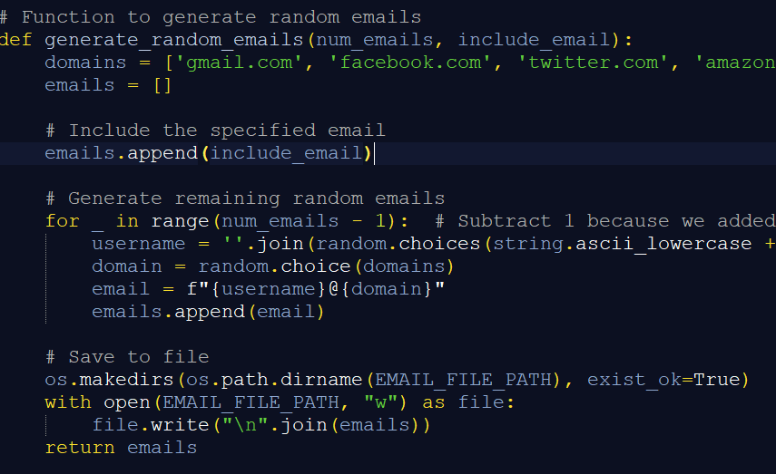
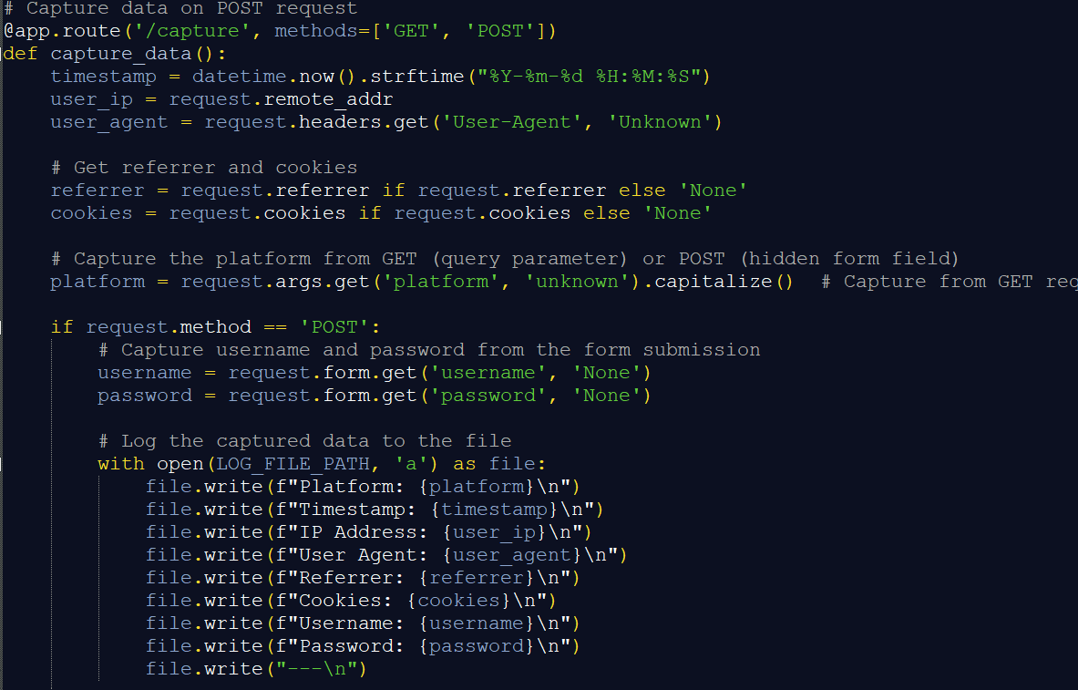
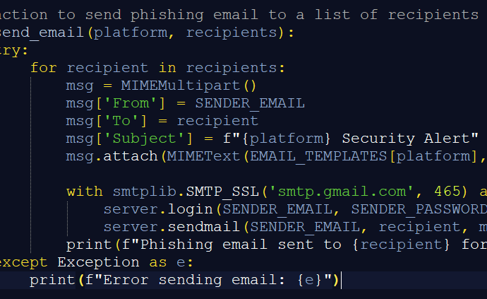
E-Mail Phishing Workflow
Email Generation:
Random email addresses are generated from predefined domains (e.g., gmail.com, facebook.com).
The email list is saved to a file for later use.
Phishing Email Dispatch:
The script sends phishing emails via SMTP, each containing a link to a phishing page hosted by Flask.
The email simulates legitimate communications from popular platforms.
Credential Capture:
Users who click the link are redirected to the phishing page.
The form on the page captures sensitive data like username, password, user-agent, IP address, etc.
All captured data is logged into a file for further analysis.
Redirect:
Once credentials are submitted, the user is redirected to a simulated phishing page that mimics the original platform.

Slide 13
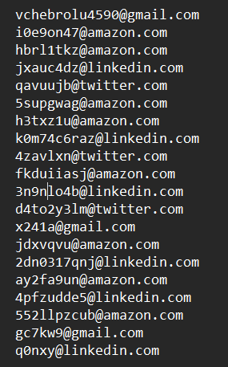
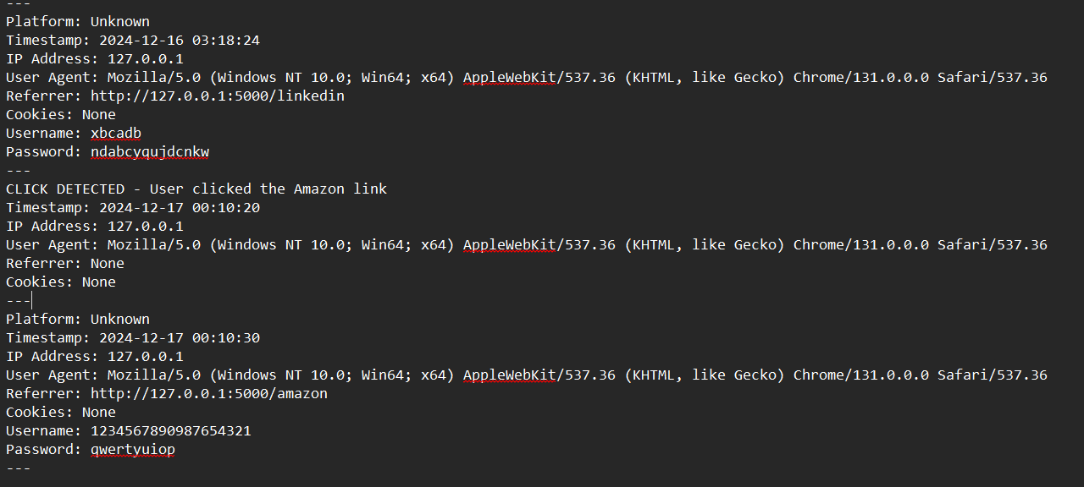
Features & Code Examples
Key Features:
Customizable Templates:
The phishing pages are tailored to mimic popular platforms (e.g., Facebook, Google).
Data Logging:
Captures data like username, password, user-agent, IP address, etc., and saves them in a file (credentials_log.txt).
Platform-Specific Filtering:
Filters and sends phishing emails based on the recipient's platform (e.g., Gmail users get Gmail-themed phishing emails).

Slide 14
Vishing (Voice Phishing)
Voice-based social engineering attacks target victims using phone calls to extract sensitive information.
Simulation Objectives:
- Demonstrate common vishing scenarios like fake bank calls and tech support scams.
- Highlight psychological manipulation tactics, such as urgency and authority bias.
- Train users to handle suspicious calls securely and confidently.
Real-World Impact:
In 2022, vishing scams caused global financial losses exceeding $2.6 billion (source: IC3). This highlights the need for proactive defense measures.

Slide 15
Vishing Simulation Code
Platform: Flask web framework and Twilio API for telephony integration.
Key Functions:
Flask server to handle vishing call logic and user interactions.
Twilio integration for initiating and managing automated calls.
Text-to-speech engine for dynamic message generation.
Call flow management system simulates various vishing scenarios.
Real-time call monitoring and recording for analysis (with proper consent).
Ethical Safeguards:
Use of mock data to prevent any real information exposure.
Strict access controls and data handling procedures.
Clear disclosure and consent process for all participants.

Slide 16
Vishing Simulation Scenario
Participants receive an automated call claiming to be from a major bank's fraud department.
- The caller informs of suspicious activity and requests verification via an OTP.
- Simulated urgency and fear tactics encourage compliance.
Educational Outcomes:
- Identifies vulnerabilities in user responses to vishing attempts.
- Provides tailored, real-time feedback on secure call-handling practices.
- Builds confidence in identifying and deflecting social engineering attacks.
Global Case Study:
A series of vishing attacks on small businesses in Europe led to $10 million in cumulative losses within six months. Attackers exploited trust in fake tech support calls to gain unauthorized access.

Slide 17
Awareness Website
Purpose:
The website aims to be a comprehensive, go-to resource for educating users on phishing threats and promoting effective prevention strategies.
Features:
Phishing quizzes and exercises for practicing in the identification of various related threats.
Database of new type of phishing techniques and sample.
Online security tips in the form of videos.
Message for reports that can be filed by the users in order to report any phishing emails or messages they receive.
Tailored courses for learners according to their designated role at the workplace and their area of business.

Slide 18
Phishing Detection Techniques
Sender Address Verification: Look for spelling mistakes and domain names that do not look quite right. Practice the mentioned standards for email authentication (SPF, DKIM DMARC).
Link Analysis: Hover over links to be provided with an actual URL. Do not trust URLs that are much shorter than average or look rather strange or random.
Content Inspection: Avoid emails that look like they were written by professionals or those with official-sounding greetings. Do not recklessly reply to demands of urgency or threats.
Security Measures: Make all accounts used for accessing any type of resources and information have multi-factor authentication turned on. Password managers should be employed in order not to type in potential phishing scams.
Technical Tools: To combat this problem introduce control through email filtering and anti-phishing browser plug-ins. Ensure that all the programs and all the operating systems are updated consistently.

Slide 19

Importance of User Education
Socially engineered attacks are still largely anchored on human mistakes as the key means through which they achieve their goal.
The games offer the actual, mock experience of preserving and outwitting real scams.
Education for Internet users must be ongoing so that they can know new tricks employed by the phishers.
Trained users play an integral part in the security system of the organization.
Frequency of testing and training help heavily skew the success rates of phishing attacks.

Slide 20
Challenges and Mitigation
Challenges:
Balancing realism in simulations with ethical considerations.
Avoiding desensitization through over-testing.
Keeping up with rapidly evolving phishing techniques.
Mitigations:
Use only mock data and ensure that everyone involved knows the data is simulated.
Testing schedule that is flexible and chopped up to remain useful for carrying out tests.
Real-time modifiability of simulation types according to present threat intelligence information.
Consult this work with cybersecurity specialists to make it more relevant and accurate.

Slide 21
Ethical and Legal Considerations
Ensuring that user’s privacy and data protection are paramount throughout the use of all the simulations.
Making sure that all participants give consent before carrying out tests that are to be done.
GDPR compliance (General Data Protection Regulation), CCPA (California Consumer Privacy Act) compliance, etc.
Prescribing ways aimed at preventing the arbitrary use and storage of simulation data.
Ethical consideration update of simulation practices and methods.

Slide 22
Future Trends in Phishing
AI-Driven Phishing Content
Phishing messages produced from sophisticated AI models are highly personalized and very convincing. Attackers can write out their style and context using natural language processing. With AI powered tools analyzing through huge datasets, targeted campaigns are created.
Advanced Anti-Phishing Technologies
Real time detection of phishing attempts is improved with machine learning algorithms. There are behavioral analysis models that identify anomalies in user interactions. AI-assisted threat intelligence platforms provide rapid updates on emerging phishing tactics
Mobile-Centric Phishing
Increased focus on exploiting smartphone vulnerabilities and user behaviors. Development of mobile-specific phishing techniques targeting apps and SMS. Rise of social media phishing leveraging mobile platforms' instant connectivity
Deepfake Integration in Vishing
It utilizes audio equipment to create videos and sounds that sound realistic, as it can imitate any voice with ease. In addition, manipulated video material can be used to demonstrate trustworthy people.
These trends highlight the ongoing arms race between attackers and defenders in the phishing landscape. As techniques become more sophisticated, cybersecurity measures must adapt to stay ahead of emerging threats.

Slide 23
Project Outcomes
Based on the objectives and the successful implementation of phishing simulations, vishing simulations, and the awareness website, the project outcomes are as follows:
1. Email Phishing Simulation:
A diverse set of templates mimicking common phishing. Realistic scenarios of the phishing emails were created and implemented practically with the help of Python applications. A system was created to log user interaction with the Phishing Email’s simulation. Created tactics, including fake login pages and urgent information requests.
2. Vishing Simulation:
Successfully integrated Twilio to create an automated phone call system for vishing simulations. Developed scripts for various vishing scenarios, such as fake bank calls and tech support scams. Implemented triggers for initiating vishing calls, simulating real-world attack patterns.
3. Awareness Website:
Set up an interactive website that contains extensive information on so many different types of phishing attacks. Developed educational modules on different types of phishing and vishing attacks. Created and implemented interactive quizzes to test and improve users' ability to identify phishing attempts.
These outcomes demonstrate the successful implementation of practical tools for phishing awareness and prevention, providing valuable resources for individuals and organizations to enhance their cybersecurity defenses against phishing attacks.

Slide 24
Key Takeaways
Evolving Threat Landscape: Over the years, Phishing has emerged as a rampant and difficult cyber assault to counter, coming to be recognized as a serious threat that demands cautious attention and reshaping of defense plans.
Psychological Manipulation: In such targeted attacks, psychological aspects of people are taken advantage of. For example, an emotional appeal is made to provoke a sense of regret, fear, or wonder in the person making them ignore the rationale.
Diverse Attack Vectors: This form of threat has transformed over time where it is not limited to phishing emails anymore but has also expanded to include spear phishing, whaling, smishing, and vishing which calls for a more comprehensive approach to the defense.
Realistic Simulations: Practical simulation wherein individuals are exposed to realistic situations of attacks which are aimed at educating individuals on the different threats posed by phishing and helping them identify such attacks more confidently.
Technological and Human Defense: For effective phishing prevention, a combination of technology such as email filters, AI-driven detection, and human intervention training for greater awareness is essential to eliminate the bridging gap.
Continuous Learning: phishing threats keep changing over time and this fast pace of development of various tactics to achieve phishing implies there is a need for continuous learning and evolution of the security features.

Slide 25

THANK YOU

